Slide 1


Hope to Skills
Lecture# 35
Irfan Malik, Dr. Sheraz Naseer

Slide 2
Our Journey
Stage 0: Orientation
Stage 1: Introduction with AI Tools
Stage 2: Python Programming
Stage 3: Concept of APIs and Hands-on
Stage 4: Hugging Face Models
Stage 5: Machine Learning Concepts

Slide 3
Our Journey
Stage 6: Data Visualizations
Stage 7: Machine Learning Models
Stage 8: Tensorflow
Stage 9: Chatbots (LangChain, Streamlit, Llama Index)
Stage 10: Pytorch

Slide 4
Agenda
Classification using Pytorch
Quick Recap of Classification
Fashion MNIST Classification
Quiz

Slide 5
Classification
Classification is a machine learning technique used to predict categorical or discrete target variables.
Types of classification problems: binary (two classes) and multi-class (more than two classes).

Slide 6
Data Preprocessing for Classification
Data preprocessing is essential to transform raw data into a suitable format for machine learning algorithms.
It involves cleaning, transforming, and encoding the data.
Preprocessing improves model accuracy, handles missing values, and deals with categorical variables.

Slide 7
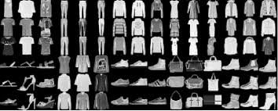
Selecting the Target Variable
The target variable is the variable we want to predict/classify.
It represents the outcome or label we are interested in.
Choose a meaningful target variable based on the problem at hand.

Slide 8
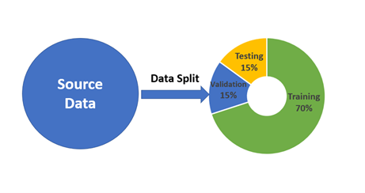
Data Splitting: Train and Test Sets
Splitting data into training and testing sets is crucial for evaluating model performance.
The training set is used to build and train the classification model.
The testing set is used to evaluate the model on unseen data.

Slide 9
Summary
Data preprocessing, target variable selection, and data splitting are crucial steps in classification tasks.

Slide 10
Colab Notebook

